Slide 1
Who Should YOU Invest?
Lending Club Kaggle Data
Presentation prepared by Giovanni Fnu

Slide 2
Background
LENDING CLUB:
A P2P LENDING COMPANY IN SF FOCUSING ON LOANS FOR INDIVIDUALS AND SMALL BUSINESSES
WHAT STARTED LENDING CLUB?
Loans from traditional financing services often come with higher rates, hidden fees, and prepayment penalties – all of which are unattractive to potential borrowers
Traditional Banks are also no longer interested in lending to small businesses and individuals w/ bad Credit/No Credit at all
Less Profit on smaller loans
Require collateral and dependent on asset, and many more
WHO’S INTERESTED?
New/seasoned investors interested in small loans with potential high-yield returns and a chance to improve someone’s financial life

Slide 3
LENDING CLUB DATASET
INFO:
LENDING CLUB DOWNLOADED FROM KAGGLE DATASET
CSV contains complete loan data for all loans issued through the 2007-2015 including the current loan status (Current, Late, Fully Paid, etc.) and latest payment information
887,379 observations
73 columns

Slide 4
GOAL
ORIGINAL GOAL:
Find out who will likely ‘default’/’charged off’ vs ‘fully paid’
TODAY’S GOAL:
Find out who will likely ‘default’/’charged off’ and predict which features are important
Default – loans for which borrowers have failed to make payments for an extended period of time
121+ days past due
Charged Off - when there is no longer a reasonable expectation of further payments
150 Days, >29 Days after ‘Default’
FUTURE’S GOAL
Combine original goal and deep dive even more

Slide 5
ENCOUNTERED PROBLEMS
Data is too big for silly/small mistakes
Takes too long to rerun/.fit()
78 features, 800K+ observations
Data is highly skewed: too many have not ‘fully paid’ and are ’current’-ly paying
There are too many NAs, string/int combinations
Had to drop a handful of features that are irrelevant:
Data is filled with features about borrowers which are not present prior to lenders issuing a loan. Since I only care for features that we, as lenders, can use to decide prior to issuing a loan, I dropped those features
I kept on going back and forth on manipulating my dataset once I found something intriguing that it wastes a lot of my time

Slide 6
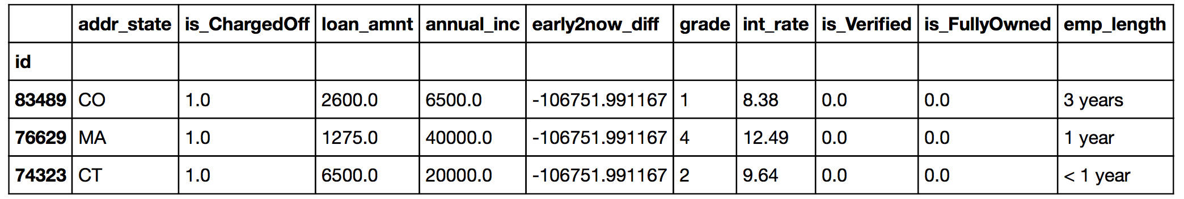
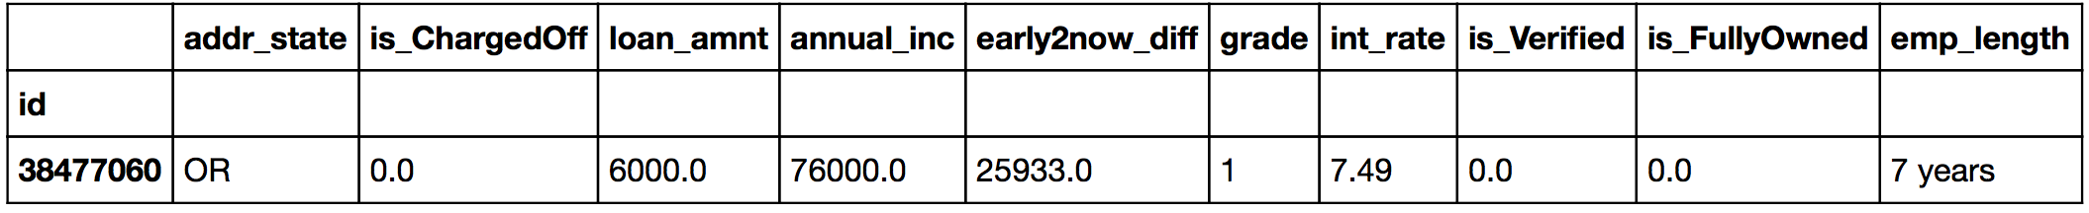
‘FUN STUFF’ I DID TO THE DATA
`Issue_d` and `earliest_cr_line` are timeframes
Did a date_diff to find the youngest and oldest credit line since opened to LC issuing a loan
We’ll talk more about this guy

Slide 7
‘FUN STUFF’ I DID TO THE DATA
Is_ChargedOff
Boolean 0/1
1.0
0.0

Slide 8
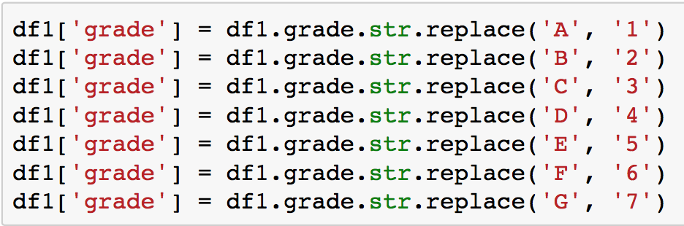
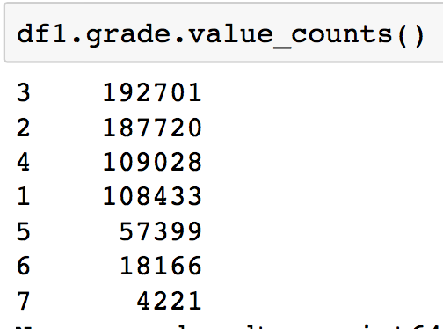
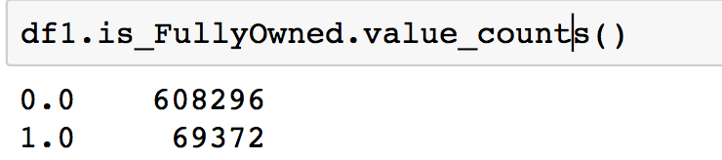
‘FUN STUFF’ I DID TO THE DATA

Slide 9
‘FUN STUFF’ I DID TO THE DATA
df1 = df1.fillna(0) – I filled every NaN with 0
Randomized and Equalized my skewed `loan_status` to prepare for Random Forest!
CO_0 = df1[df1.is_ChargedOff == 0.0]
CO_1 = df1[df1.is_ChargedOff == 1.0]
n = min([len(CO_0), len(CO_1)])
CO_0 = CO_0.sample(n = n, random_state = 0)
CO_1 = CO_1.sample(n = n, random_state = 0)
df1s = pd.concat([CO_0, CO_1])

Slide 10
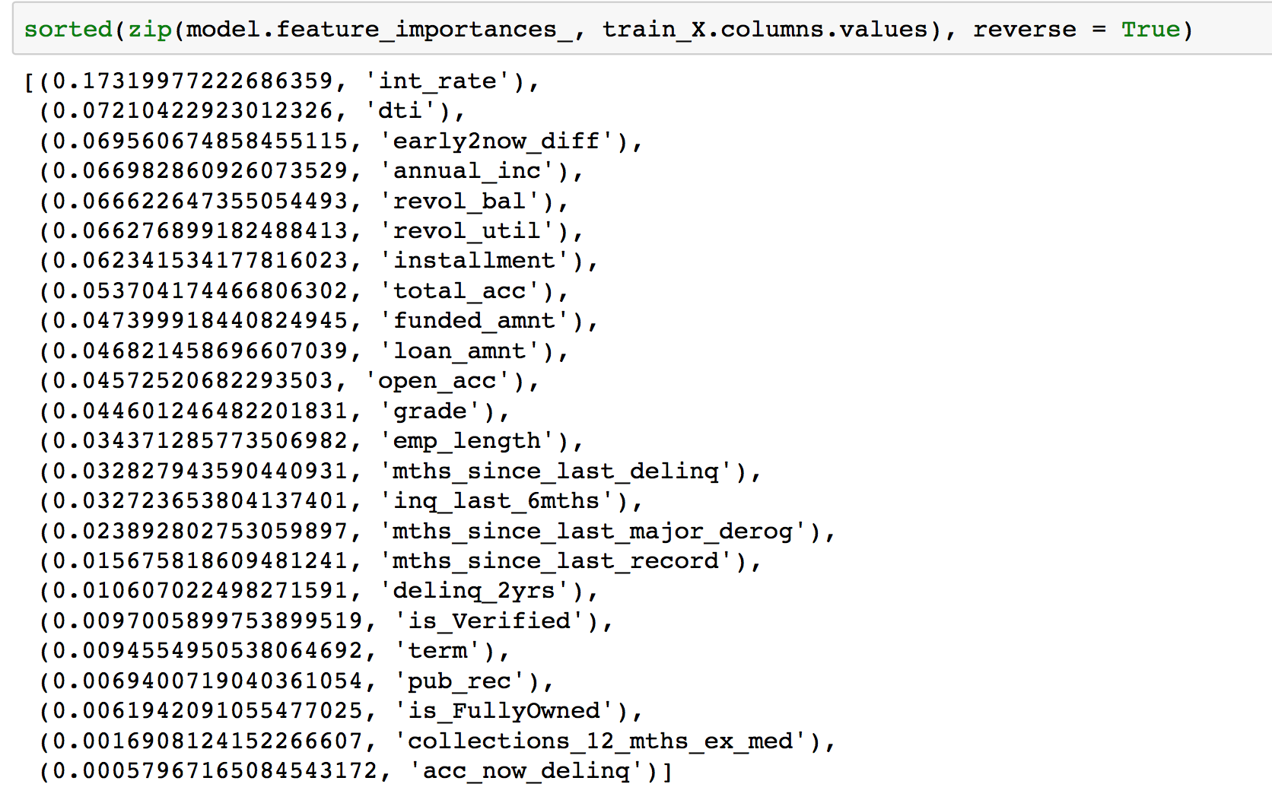
Random Forest
model.score(test_X, test_y)
0.7351454357779954
(test_y_hat == test_y).mean()
0.7351454357779954
NOT
THAT
GREAT

Slide 11
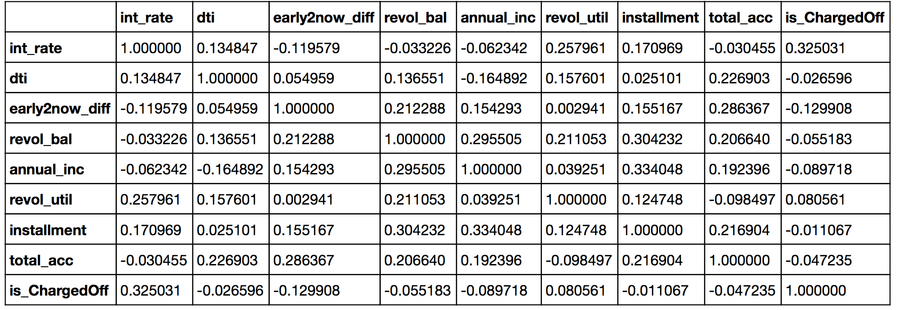
Correlation
Which means?
Notes:
Ask people in the audience for engagement (in case it gets boring)

Slide 12
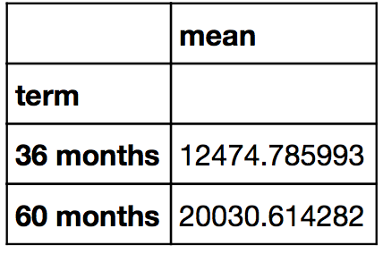
Short Deep Dive in LC Data
Left-skewed between 5k-20k loans
Average loans for 36mo around $12,475
And 60mo around $20,031

Slide 13
Interest Rate Overview
`Charged Off` and `Default` incidents happen when interest rate is as high as ~16%
Even `In Grace` and `Late`
Despite skewed `loan_status` that shows `Current` count higher than other status, majority averaged around 13%
`Fully Paid` individuals/small businesses averaged around 13-13.5% as well

Slide 14
DTI Mean Per Status
In average if you’re in the >= 20s, you’re more likely to default
`Fully Paid` average is around 16 DTI (close, very close)
Source: http://www.clearpoint.org/blog/what-is-a-good-debt-to-income-ratio-anyway/

Slide 15
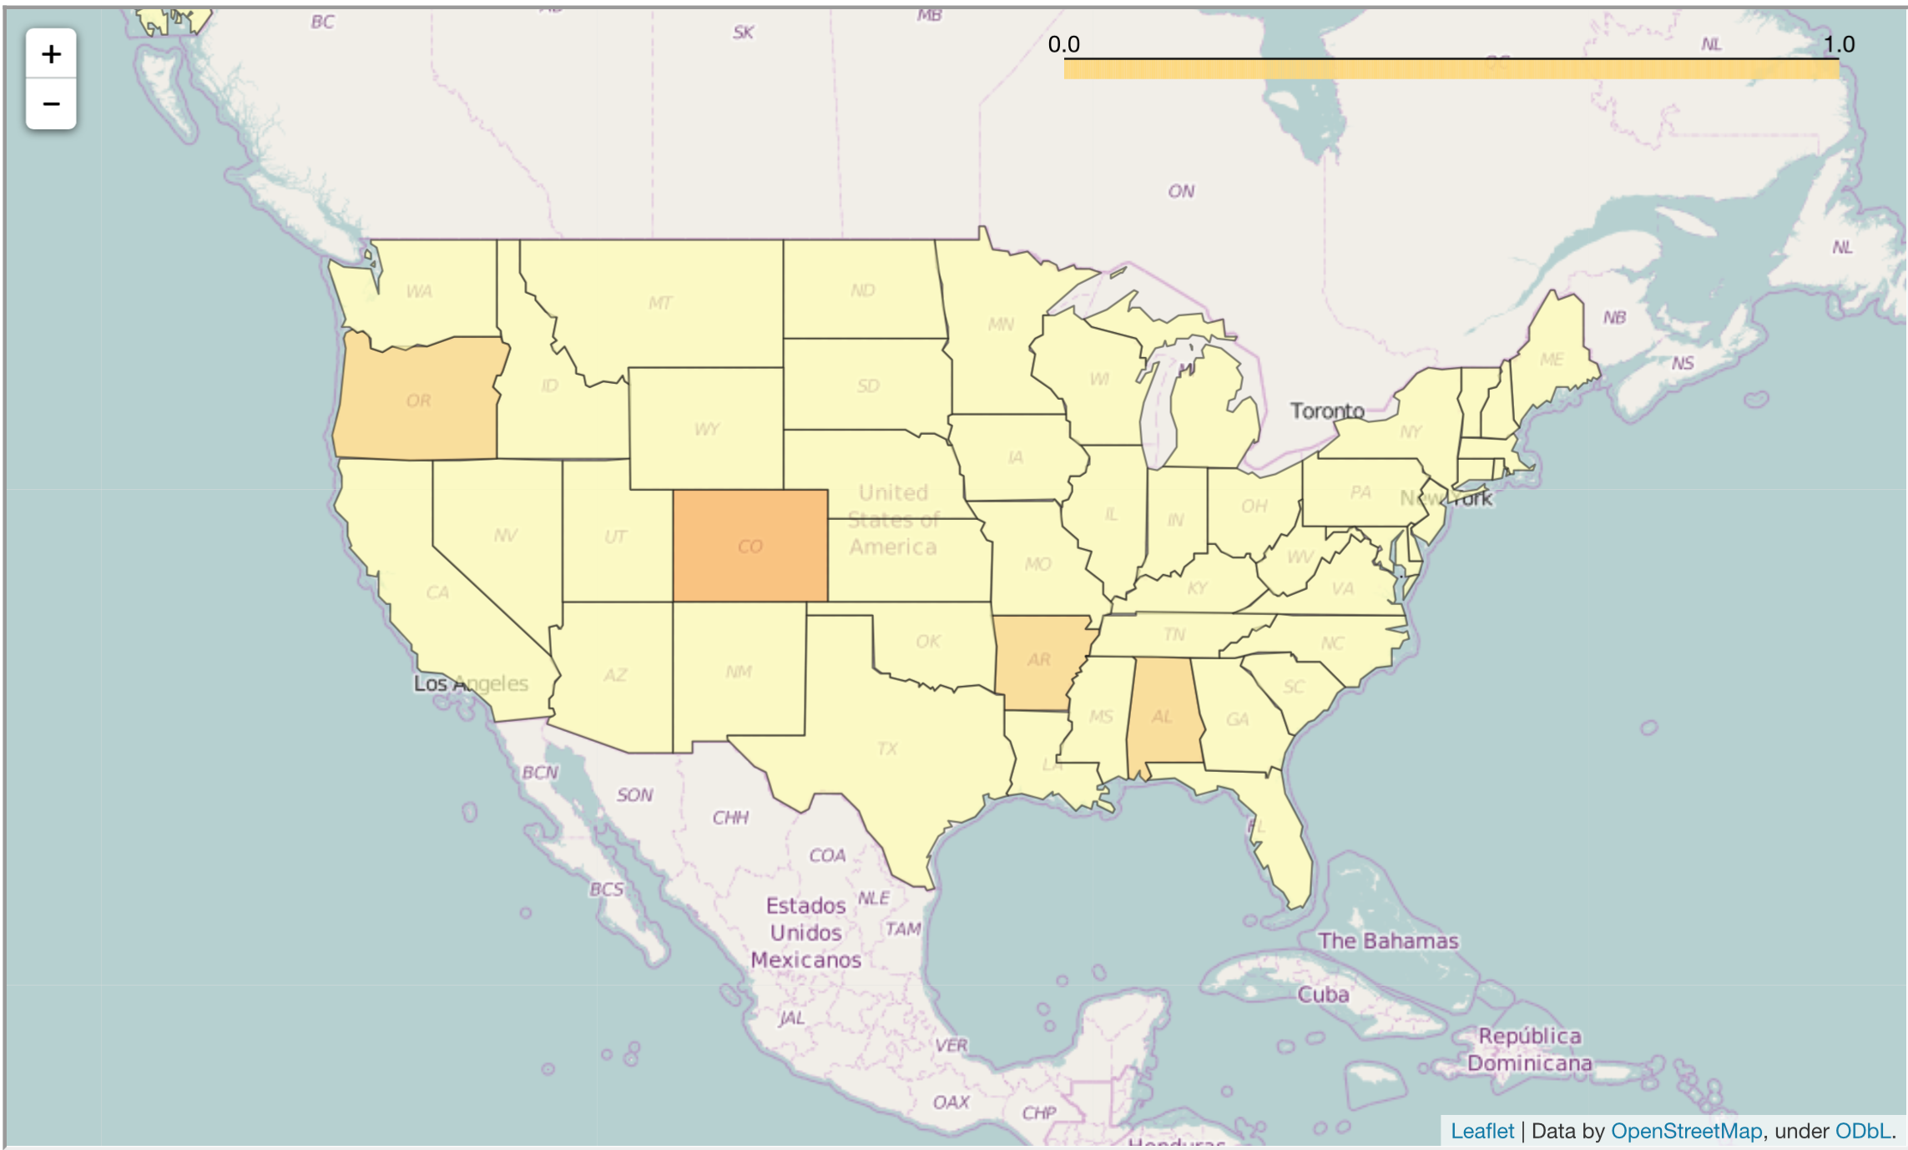
WHERE DO `CHARGED OFF` OCCUR MOST?
According to LC Data:
Colorado
Oregon
Arkansas
Alabama
So try to MAYBE avoid these states?

Slide 16
Remember this Individual? (From earlier slides)
This individual is an interesting one – what do you guys think?
“I would like to refinance my credit card debt ...”
Caught in a lie or is there other debt not recorded? (Any ideas?)
Not even verified!
Key takeaway at the end

Slide 17
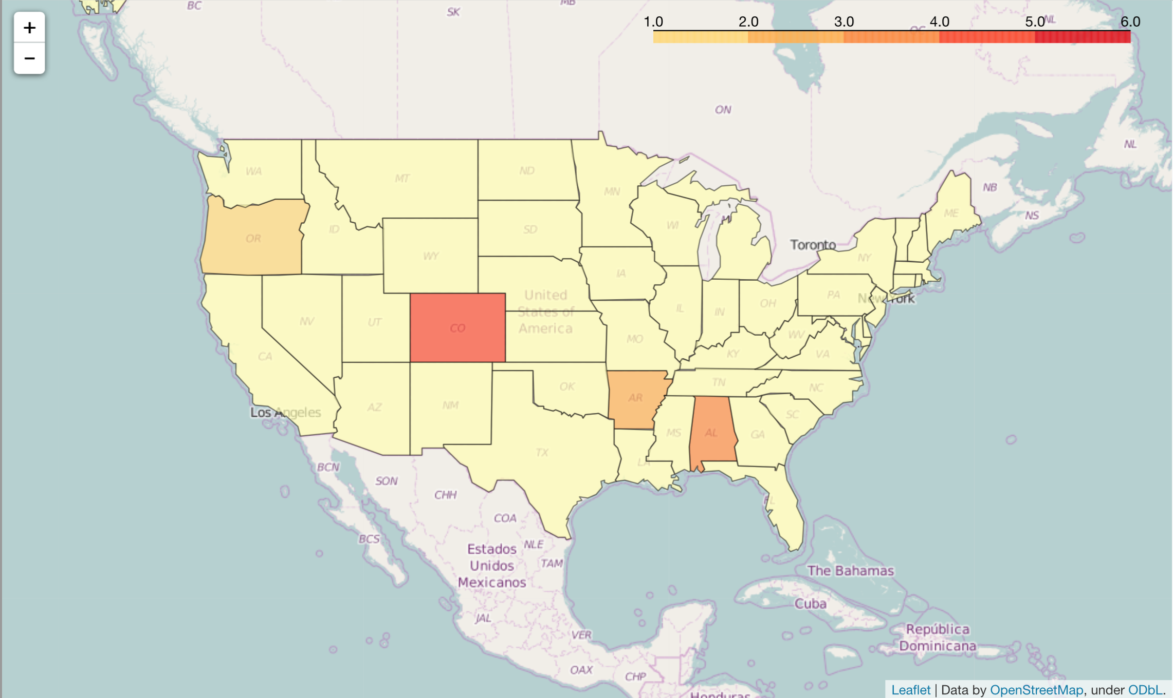
WHERE DO WORST GRADES EXIST?
B C D E F
According to LC Data:
Colorado
Alabama
Arkansas
Oregon
🤔
Coincidence?
Note: No A included

Slide 18
A Couple of Takeaways
CO Lie?
Don’t fall for ’Non-verified’ accounts coming from CO, which seems too good to be true EVEN IF the int_rate is not as risky
Try to stay away from these States if the data doesn’t seem convincing enough
Safest DTI seems to be around <16 on average and average Interest Rate between 13-13.5%
Important features to look into:
int_rate
dti
early2now_diff (issue_d - earliest_cr_line )
annual_income
Revol_bal
Revol_util
Installment
Total_account

Slide 19
Credits
Folium documentation
LC Kaggle Data – Lending Club
Few definitions:
revol_bal
Total credit revolving balance
revol_util
Revolving line utilization rate, or the amount of credit the borrower is using relative to all available revolving credit.
total_acc
The total number of credit lines currently in the borrower's credit file
installment
The monthly payment owed by the borrower if the loan originates.
int_rate
Interest Rate on the loan
issue_d
The month which the loan was funded
dti
A ratio calculated using the borrower’s total monthly debt payments on the total debt obligations, excluding mortgage and the requested LC loan, divided by the borrower’s self-reported monthly income.
earliest_cr_line
The month the borrower's earliest reported credit line was opened
annual_inc
The self-reported annual income provided by the borrower during registration.

Slide 20
…Just a Beginning!
Q&A

